Slide 1
Introduction
What is a Network?
What is “Network Design”?
Top-Down Network Design
Network Development Life Cycle (NDLC)
Network Analysis and Design Methodology
Types of Network Design

Slide 2
What is a Network?
Management view
Technical view

Slide 3
The Management View (1/3)
A network is a utility
  Computers and their users are customers of the network utility
The network must accommodate the needs of customers
  As computer usage increases so does the requirements of the network utility
Resources will be used to manage the network
The Network Utility is NOT free!
  Someone must pay the cost of installing and maintaining the network
  Manpower is required to support the network utility

Slide 4
The Management View (2/3)
As a network designer, you need to explain to management how the network design, even with the high expense, can save money or improve the company’s business
  If users cannot log on to your commerce site, they will try your competitor, and you have lost sales
  If you cannot get the information your customers are asking about due to a network that is down, they may go to your competitor

Slide 5
The Management View (3/3)
You need to understand how the network assists the company in making money and play on that strength when you are developing the network design proposal
Try to show a direct correlation between the network design project and the company’s business
  “Because you want a faster network” is not good enough, the question that management sends back is WHY DO I NEED A FASTER ONE?

Slide 6
The Technical View (1/2)
A “Network” really can be thought of as three parts and they all need to be considered when working on a network design project:
  Connections
  Communications/Protocols
  Services
Connections
  Provided by Hardware that ties things together
    Wire/Fiber/Wireless Transport Mechanisms
    Routers
    Switches/Hubs
    Computers

Slide 7
The Technical View (2/2)
Communications/Protocols
  Provided by Software
  A common language for 2 systems to communicate with each other
    TCP/IP (Internet/Windows NT)
    IPX / SPX (Novell Netware 4)
    AppleTalk
    Other Network OS
Services
  The Heart of Networking
  Cooperation between 2 or more systems to perform some function - Applications
    telnet
    FTP
    HTTP
    SMTP : Simple Mail Transfer Protocol

Slide 8
Traditional Network Design
Based on a set of general rules
  “80/20”: Where 80% of a network’s traffic is local and 20% is remote
  “Bridge when you can, route when you must”
  Can’t deal with scalability & complexity
Focused on capacity planning
  Throw more bandwidth at the problem
  No consideration to delay optimization
  No guarantee of service quality
  Less importance given to network RMA (Reliability, Maintainability, and Availability) compared to throughput

Slide 9
Top-Down Network Design
Network design should be a complete process that matches business needs to available technology to deliver a system that will maximize an organization’s success.
  In the LAN area it is more than just buying a few devices.
  In the WAN area it is more than just calling the phone company.

Slide 10
Start at the Top
Don’t just start connecting the dots.
Analyze business and technical goals first.
Find out who the network serves and where they reside.
Determine what applications will run on the network and how those applications behave on a network.
Focus on Layer 7 and above first.
Notes:
Layer 8 of the OSI model encompasses office politics, budgets, training, and other human factors.

Slide 11
Layers of the OSI Model
Layer 7
Application
Layer 6
Presentation
Layer 5
Session
Layer 4
Transport
Layer 3
Network
Layer 2
Data Link
Layer 1
Physical

Slide 12
Structured Design
A focus is placed on understanding data flow, data types, and processes that access or change the data.
A focus is placed on understanding the location and needs of user communities that access or change data and processes.
Several techniques and models can be used to characterize the existing system, new user requirements, and a structure for the future system.
A logical model is developed before the physical model.
  The logical model represents the basic building blocks, divided by function, and the structure of the system.
  The physical model represents devices and specific technologies and implementations.

Slide 13
Top-Down Network Design Steps
Analyze requirements
Monitor and optimize network performance
Develop logical design
Implement and test network
Develop physical design
Test, optimize, and document design

Slide 14
Network Design Steps
Phase 1 – Analyze Requirements
  Analyze business goals and constraints
  Analyze technical goals and tradeoffs
  Characterize the existing network
  Characterize network traffic

Slide 15
Network Design Steps
Phase 2 – Logical Network Design
  Design a network topology
  Design models for addressing and naming
  Select switching and routing protocols
  Develop network security strategies
  Develop network management strategies

Slide 16
Network Design Steps
Phase 3 – Physical Network Design
  Select technologies and devices for campus networks
  Select technologies and devices for enterprise networks

Slide 17
Network Design Steps
Phase 4 – Testing, Optimizing, and Documenting the Network Design
  Test the network design
  Optimize the network design
  Document the network design

Slide 18
The PDIOO Network Life Cycle
Plan
Design
Retire
Optimize
Implement
Operate

Slide 19
Business Goals
Increase revenue
Reduce operating costs
Improve communications
Shorten product development cycle
Expand into worldwide markets
Build partnerships with other companies
Offer better customer support or new customer services

Slide 20

Business Constraints
Budget
Staffing
Schedule
Politics and policies

Slide 21
Collect Information Before the First Meeting
Before meeting with the client, whether internal or external, collect some basic business-related information
Such as
  Products produced/Services supplied
  Financial viability
  Customers, suppliers, competitors
  Competitive advantage

Slide 22

Meet With the Customer
Try to get
  The goals of the project
    What problem are they trying to solve?
    How will new technology help them be more successful in their business?
    What must happen for the project to succeed?

Slide 23

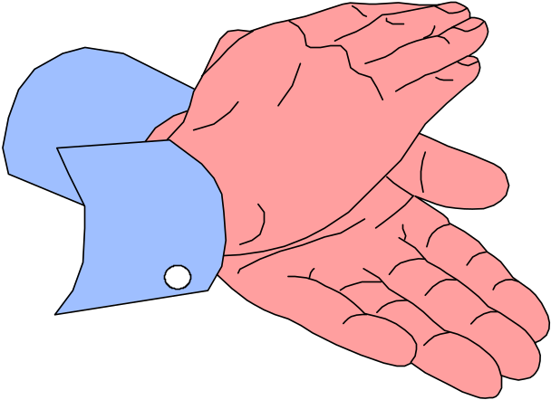
Meet With the Customer
What will happen if the project is a failure?
  Is this a critical business function?
  Is this project visible to upper management?
  Who’s on your side?

Slide 24

Meet With the Customer
Discover any biases
  For example
    Will they only use certain company’s products?
    Do they avoid certain technologies?
    Do the data people look down on the voice people or vice versa?
  Talk to the technical and management staff

Slide 25
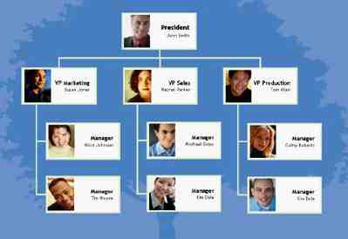
Meet With the Customer
  Get a copy of the organization chart
    This will show the general structure of the organization
    It will suggest users to account for
    It will suggest geographical locations to account for

Slide 26
Meet With the Customer
  Get a copy of the security policy
    How does the policy affect the new design?
    How does the new design affect the policy?
    Is the policy so strict that you (the network designer) won’t be able to do your job?

Slide 27
Network Applications
Name of Application
Type of Application
New Application?
Criticality
Comments

Slide 28
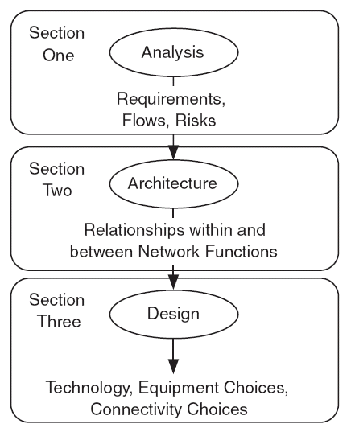
Information Flows between Network Analysis, Architecture, and Design

Slide 29
Customer’s Requirements
- Understanding the Customer -
A good network design must recognize the customer’s requirements - need to make sure your design meets THEIR needs and not just YOURS!
The “Customer” may be your own firm, the “who” you are designing the network for
Need an overview of a customer’s requirements
The best designed network will fail without the support of people

Slide 30
Customer’s Requirements
- Users’ Needs -
What do the users want?
  Services
What do the users need?
What don’t they know but they need?
Organize and Prioritize Requirement

Slide 31
Customer’s Requirements
- How they are used -
User Requirements →
Performance Requirements
Timeliness
Interactivity
Reliability
Quality
Security
Affordability
User Numbers
User Locations
User Growth
Delay
Reliability
Capacity
Notes:
Affordability القدرة على تحمل التكاليف

Slide 32
Analysis and Design Processes
Set and achieve goals
  Maximizing performance
  Minimizing cost
Optimization with trade-offs
  Recognizing trade-offs
  No single ‘best’ answer
Hierarchies
  Provide structure in the network
Redundancy
  Provides availability & reliability

Slide 33
Approaches Used for Design
Heuristic – by using various algorithms
Exact – by working out mathematical solutions based on linear programming, etc., minimizing certain cost functions
Simulation – often used when no exact analytical form exists. Experiments are conducted on simplified models to see the performance of a network
Notes:
In this course we will be investigating mainly two approaches – heuristic

Slide 34
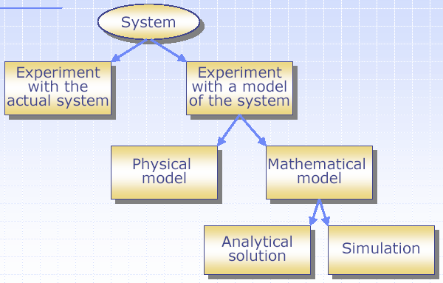
Design and Study of a System

Slide 35
Art or Science?
The Art of Network Design
Technology choices
Relations to business goals
The Science of Network Design
  Understanding of network technologies
  Analysis of capacity, redundancy, delay …

Slide 36
Types of Network Design
New network design
Re-engineering a network design
Network expansion design

Slide 37
New Network Design
Actually starting from scratch
No legacy networks to accommodate
Major driver is the budget, no compatibility issues to worry about
Getting harder to find these situations
Notes:
No legacy networks to accommodate
لا توجد شبكات قديمة لاستيعابها

Slide 38
Re-engineering a Network Design
Modifications to an existing network to compensate for original design problems
Sometimes required when network users change existing applications or functionality
More of the type of problems seen today

Slide 39
Network Expansion Design
Network designs that expand network capacity
Technology upgrades
Adding more users or networked equipment

